Slide 1
HR Information System
By:
Lisa Patel
Mukesh Ganesh
Vishakha Srivastava
Resham Uttamchandani

Slide 2
What is HR Information System?
Digital solution for managing and optimizing the daily human resources tasks and overall HR goals of an organization.
HR software makes it possible for HR staff and managers to better allocate their time and resources to more productive, profitable efforts.
Who are the users?
HR Professionals.
Support Staff.
Employees
Executives and Directors.

Slide 3
Why do we need it?
Effective Time Management
Labour Management
Data Visualization
Strategic focus
Notes:
Efficiency of Administration
If you’ve got more than a few dozen people working for you it can become an administrative nightmare keeping track of basic employee information if you rely solely on a paper-based system. Simple questions such as ‘How much holiday have I taken?’ and ‘Can I have a copy of my last 3 payslips?’ become extremely time consuming.
Reduced cost
1 HR professional per 100 employees. With some software solutions this ratio is approximately 1 HR professional per 140 employees, meaning a company of 280 employees requires one less full time member of staff simply to manage their workforce data, resulting in reduced costs of tens of thousands of pounds annually.
Data Analysis
you might discover that a department has a particularly high employee turnover rate. Why is that? Did the leavers all work for the same line manager? Who is that manager? Do they need training? Who are your top sales performers? What are their characteristics? Were they all recruited from the same place? Do they work for the same line manager? If you collect the data you can interrogate it and use that analysis to inform your decisions. The effort required in getting the same insight using a paper-based system simply makes this type of analysis unfeasible.
Improved Communication
employees tend to work with the same people and, therefore, have their contact information, often times their job requires reaching out to colleagues outside of their immediate department. If all this contact information is stored in a filing cabinet it slows down communication massively.
Risk Mitigation
In the event of a legal dispute, how can you prove that an employee was made aware of a particular policy or trained on how to use a particular piece of equipment? Email communication is fine but it is not unheard of someone denying seeing an email. Many of today’s HR systems offer a read and accept facility that provides a paper trail not only showing that an employee was sent a particular message but that they also have accepted the contents of the communication.
Security and Disaster Recovery
If you keep all your employee information in a filing cabinet how secure is that? Who has access to it? How would you know if someone has tried to access it? With modern HR systems the information is extremely secure, think bank level security

Slide 4

EasyWorks
HR Software so you can focus on the people, not the paperwork.
EasyWorks automates operational-tasks and frees HR to perform the big picture projects that makes a difference. Designed to be used by everyone, everyday
OUR FEATURES :
Onboarding User Administration
Training Time-Off
Payroll Benefits
Timeline Tracker

Slide 5
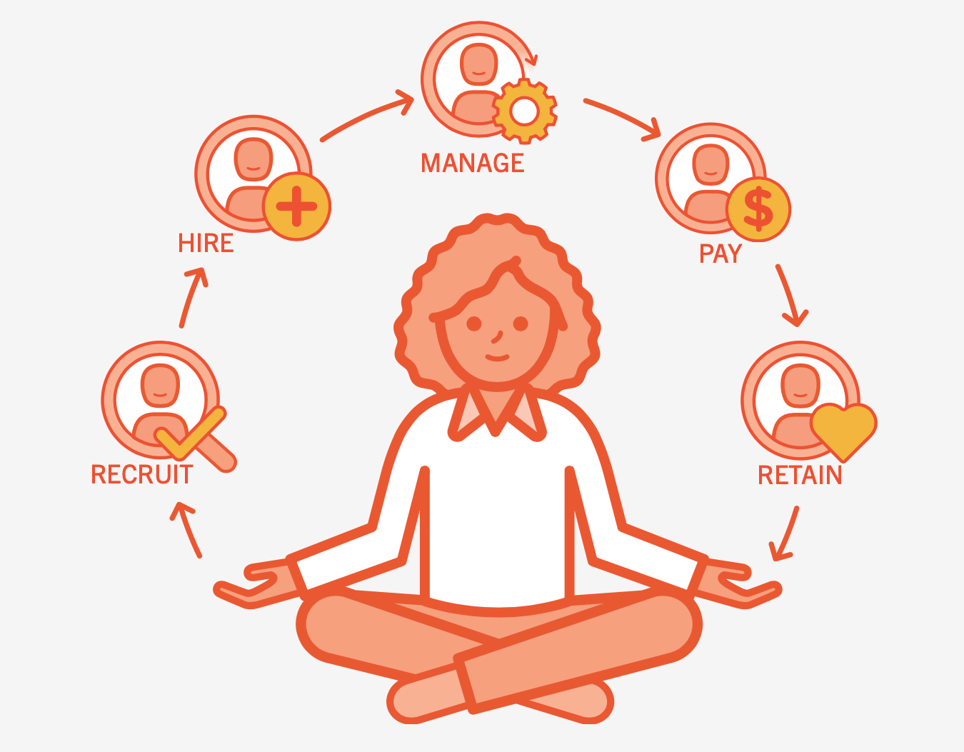
Our Agenda
Easy to Adapt and Easy to Use
Access to available services 24/7
Define and align organizational purpose
Recruit the best talent & retain them
Focus on employee strengths, help employees train & evolve
Create organizational alignment
Accurately measure the same things
Notes:
Achievements must align with the organization’s objectives so as to build a successful and sustainable organization
All internal departments and employees must be measuring the same things as to achieve a definitive organizational result and to ensure that everyone knows exactly where the organization is at all times
Companies must make every effort to understand what candidates and employees do best and put them into roles where they can play to their strengths as much as possible.

Slide 6
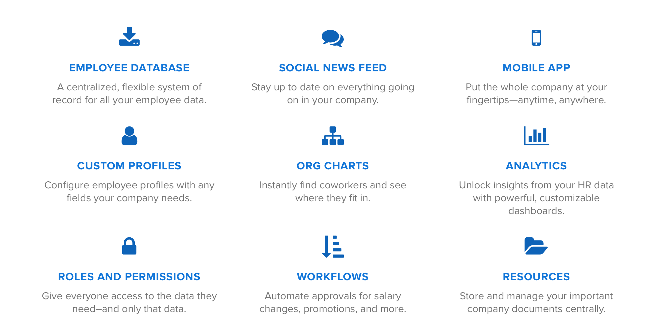
How EasyWorks will help?

Slide 7
Demo

Slide 8
Future plan
Our open API allows third-party developers to integrate applications on EasyWorks
EasyWorks will integrate with top job boards and social media sites to post jobs.
EasyWorks will also assist the Applicant tracking process through ATS and interviewing processes for more streamlined hiring
Provide an interactive chatbot for employees for any system related queries.

Slide 9
THANK YOU!

